Slide 1
Capstone Project - Phase B
Co-Bie
Expand your social circle by connecting with individuals who share your hobbies
Students
Raz Avraham
Amit Kempner
Supervisor
Prof.Zeev Brazily

Slide 2






Roadmap
Background
Features
Architecture
Verification
Product
Challenges

Slide 3
Background
Have you ever had a hobby that you had no one to share it with?

Slide 4
Features
1
2
3
Create an event
(Physical / Virtual)
Google Maps
Clarity and Simplicity
Clarity and Simplicity
Live Chat
4
5
6
Notifications
Reviews
Clarity and Simplicity
Clarity and Simplicity
Matching Hobbies

Slide 5
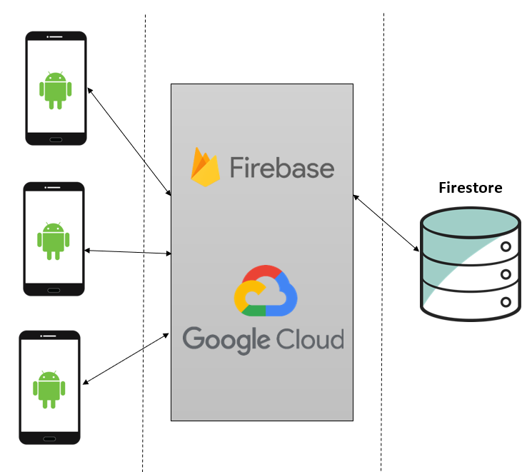
Software Architecture

Slide 6
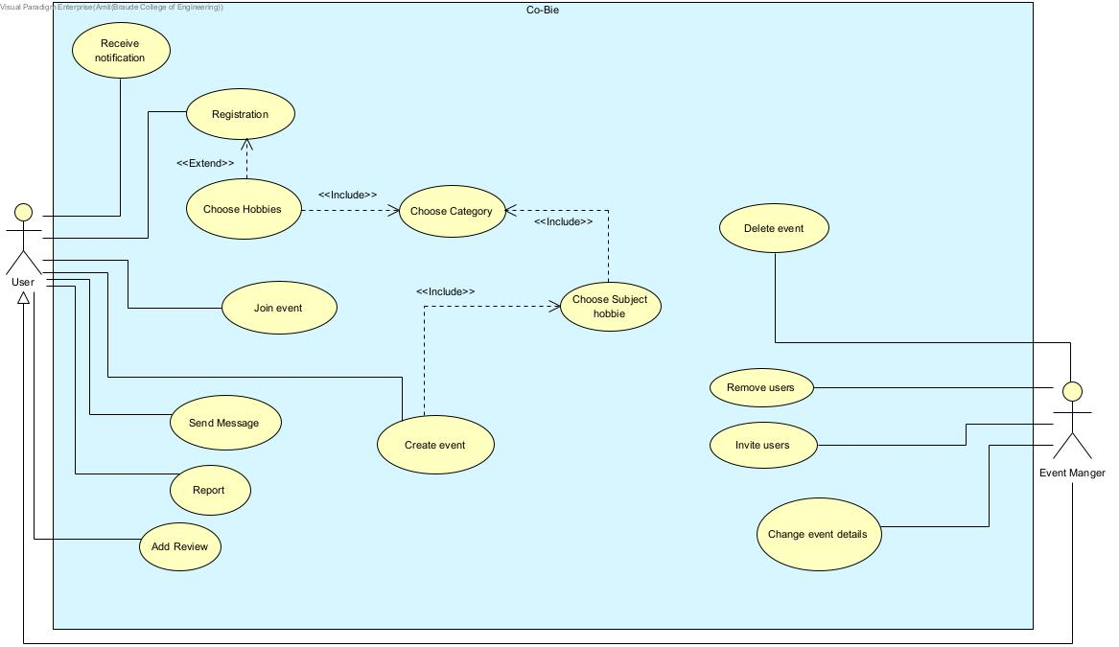
Use-Case Diagram

Slide 7
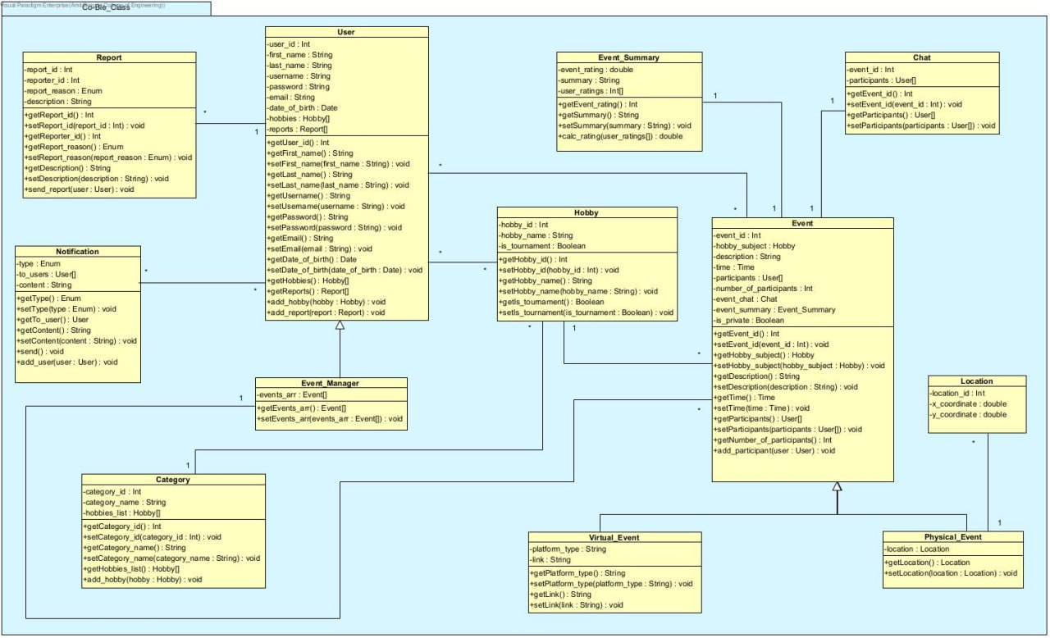
Class Diagram

Slide 8
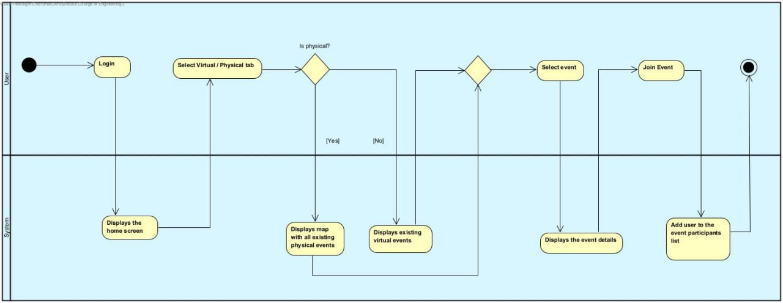
Activity Diagram
Join Event

Slide 9
Verification
Unit Testing
Create an Event
Number | Test Subject | Expected Result
1 | Event created successfully | Event added to the event table in the DB with appropriate details
2 | Event creation failed (as a result of invalid fields) | Event has not been added to the events table in the DB
3 | Event creation failed (as a result of system failure) | Event has not been added to the events table in the DB - throw an exception

Slide 10
Add Review
Number | Test Subject | Expected Result
1 | The user add review successfully | Review has been added to the event reviews list in the DB
2 | Failed to add review (as a result of invalid fields) | Review has not been added to the event reviews list in the DB
3 | Failed to add review (as a result of system failure) | Review has not been added to the event reviews list in the DB – throw an exception

Slide 11
Functional Testing
Registration
Number | Test Subject | Expected Result
1 | Enter a username that already exists in the system | System Displays: “The username already exists, try another”
2 | Enter a password shorter than 8 characters | System Displays: “The password is too short, please enter at least 8 characters”
3 | Enter an email that already exists in the system | System Displays: “The email address is already being used”
4 | Enter invalid email address | System Displays: “Invalid email address”
5 | According to the date of birth entered, the user is under the age of 16 | System Displays: “The use of the application is only allowed from the age of 16 and above”
6 | There is an empty field | System Displays: “Please fill all required fields”
7 | The registration has been successfully completed | System switches to user home page screen

Slide 12
Create an Event
Number | Test Subject | Expected Result
1 | Invalid time | System Displays: “Please enter valid time”
2 | There is an empty field | System Displays: “Please fill all required fields”
3 | No hobby selected | System Displays: “Please select the event hobby”
4 | If the event is physical and no location selected | System Displays: “Please select the event location”
5 | If the event is virtual and no link has been inserted | System Displays: “Please enter the event meeting link”
6 | User selected physical event | System displays a map to choose a location to the meeting
7 | User selected virtual event | System displays a text box to insert a link to the meeting
8 | Event created successfully | System switches to the event screen

Slide 13


Demonstration

Slide 14
Challenges
Maps and Location Management
Android Services & Notifications
Matching suggested events based on hobbies
Develop a user-friendly application
Using cloud computing

Slide 15

Join us in creating a community where everyone can share and enjoy their hobbies

